Slide 1




Change Request YOE Portal
Hasil Review dan Feedback
HIMBARA
September 2022
Organized by

Slide 2
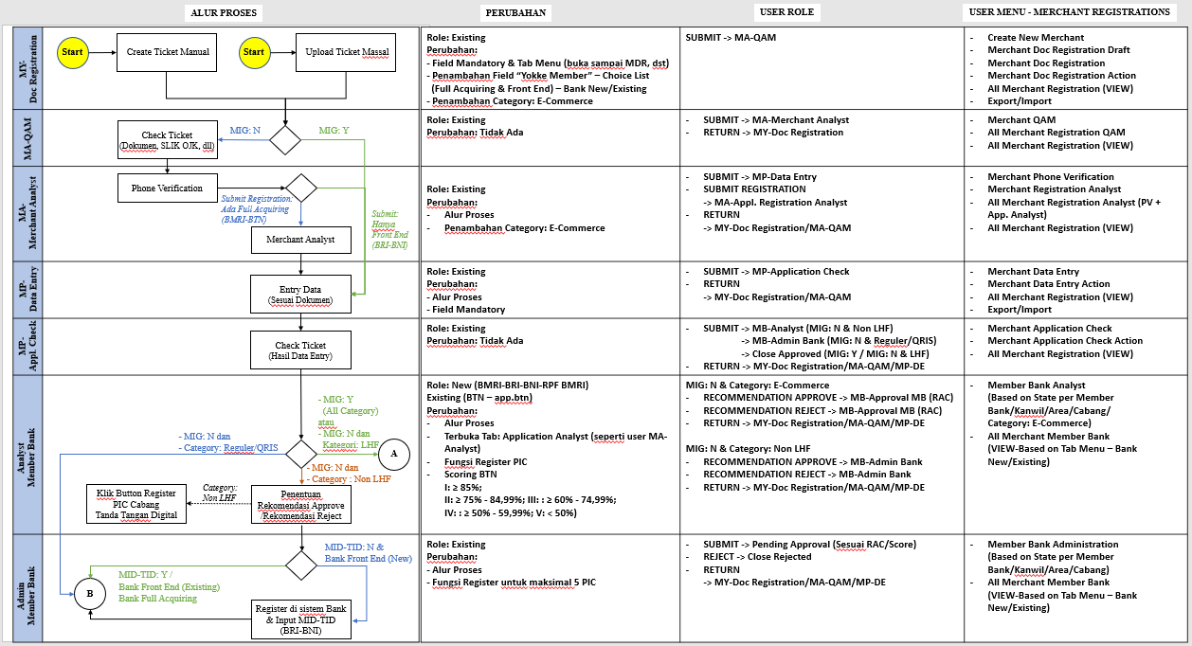
CHANGE REQUEST - ALUR PROSES

Slide 3
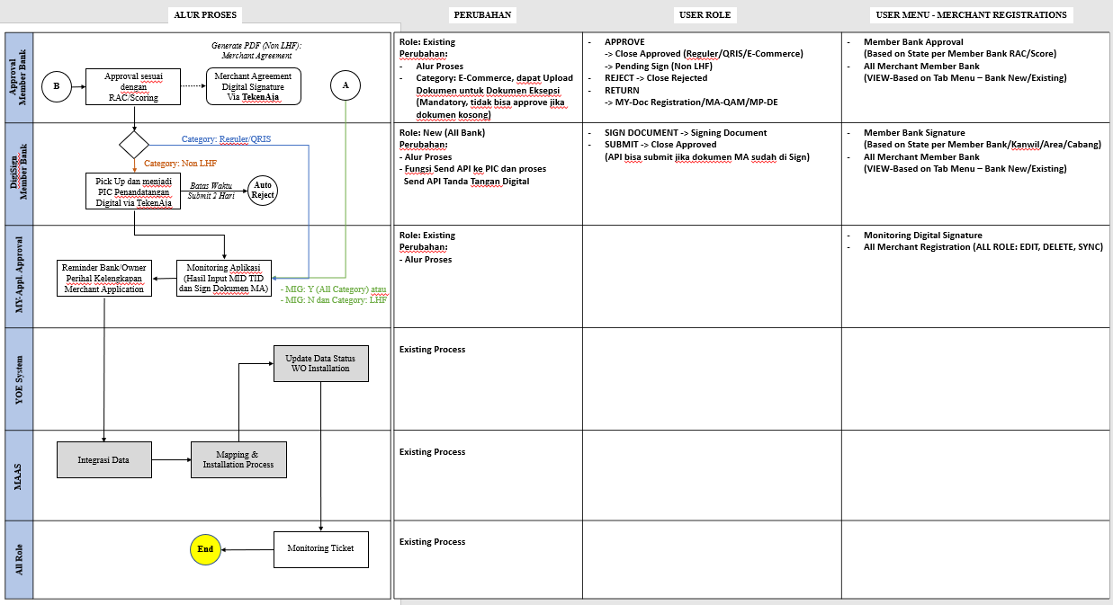
CHANGE REQUEST - ALUR PROSES

Slide 4
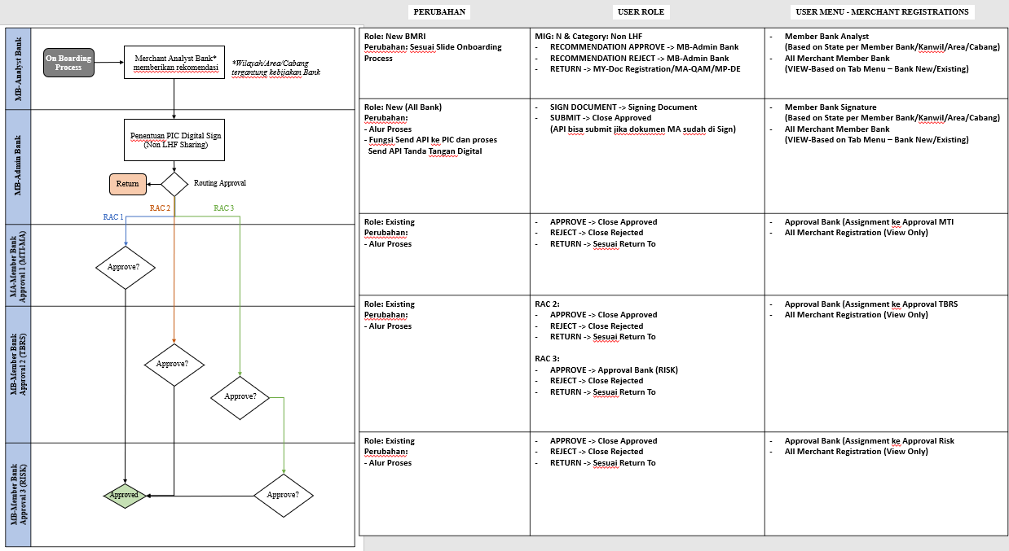
CHANGE REQUEST - ALUR APPROVAL EDC/QRIS BMRI

Slide 5
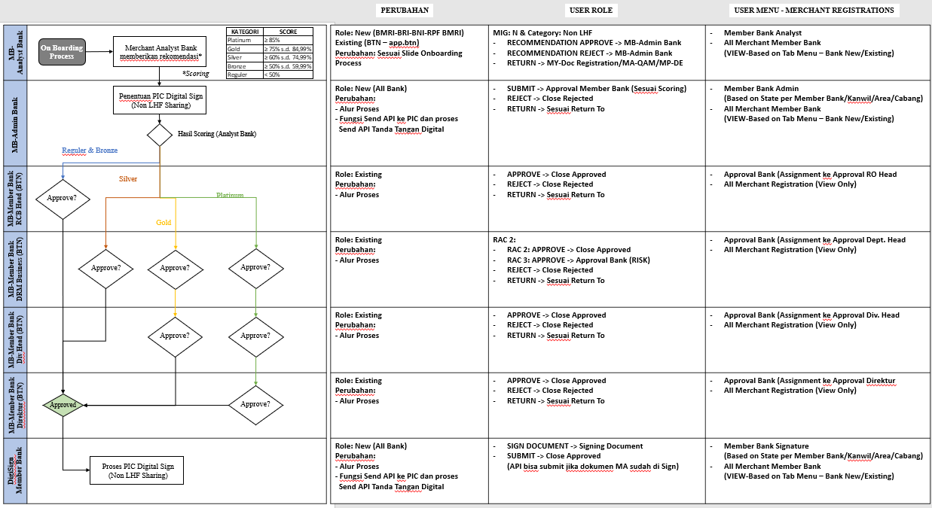
CHANGE REQUEST - ALUR APPROVAL EDC BTN

Slide 6
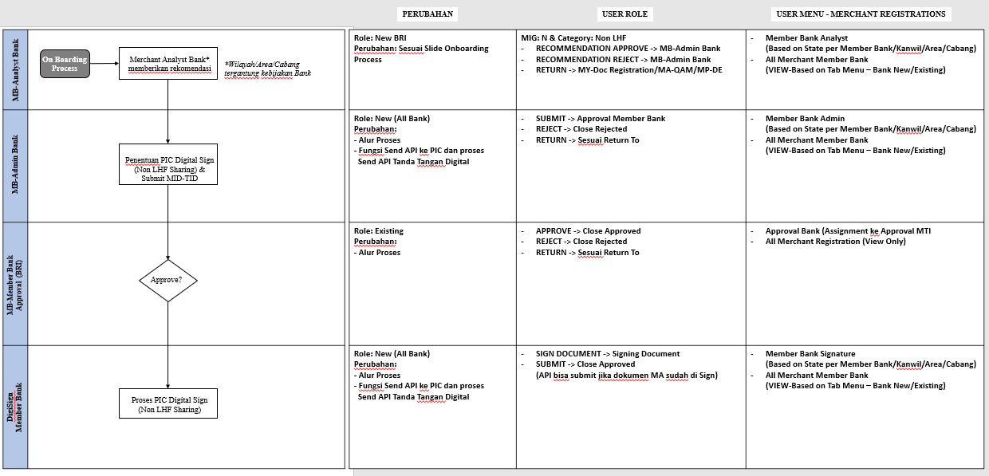
CHANGE REQUEST - ALUR APPROVAL EDC BRI

Slide 7

CHANGE REQUEST - ALUR APPROVAL EDC BNI

Slide 8
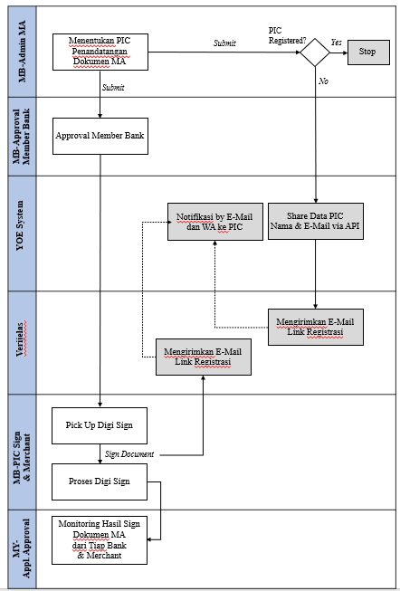
CHANGE REQUEST - ALUR DIGITAL SIGNATURE

Slide 9
CHANGE REQUEST – FIELD DATA MERCHANT

Slide 10
CHANGE REQUEST – FIELD DATA MERCHANT

Slide 11
CHANGE REQUEST – FIELD DATA MERCHANT

Slide 12
CHANGE REQUEST – FIELD DATA MERCHANT

Slide 13
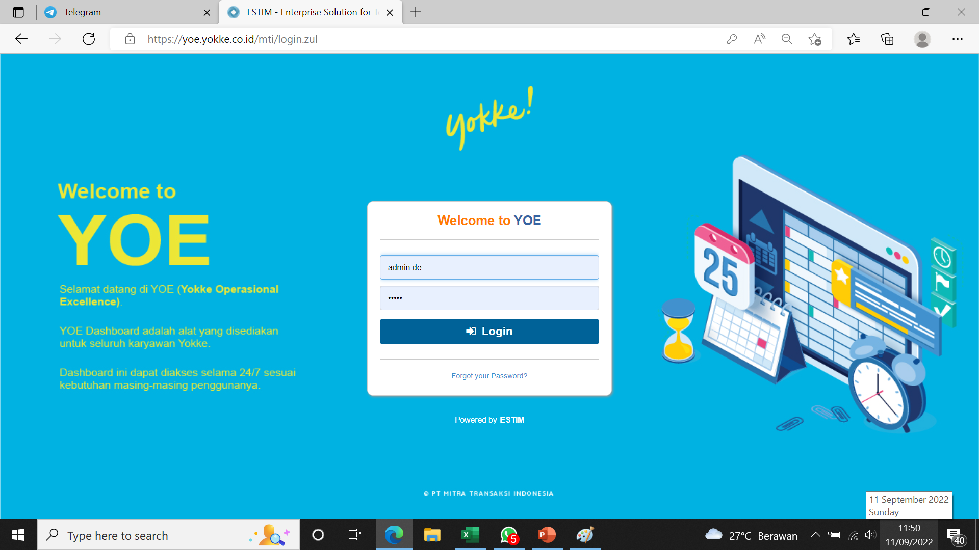
CHANGE REQUEST – BLACKLIST CHECK
ALUR UPDATE DATABASE BLACKLIST
DB MAAS | DWH | DB YOE | YOE
DB MAAS
DWH
DB YOE
ALUR PENGECEKAN DATABASE BLACKLIST MERCHANT
MY-Doc Registration | MA-QAM | MP-Data Entry | DB YOE
Upload Data/
Create Aplikasi Baru
Pengecekan Dokumen dan Cek SLIK
Input Data Profil Merchant
Klik Button “Check Blacklist”
Pengecekan ke Database Blacklist
Otomatis Update di Tab Review

Slide 14
CHANGE REQUEST – BLACKLIST CHECK
QUERY TABLE DATABASE YOE (DB YOE)
SELECT
B.CD_EXPL AS BL_REGISTER, A.ACCI_REG_INST_CD, A.REG_DATE,
A.MER_NM, A.RPSV_FNM, A.MER_ALL_ADDR, A.RPSV_TEL_NO,
A.KTPNO, A.NPWP, A.BL_STAT_CTNTS, A.BL_APPL_YN
FROM TBMCOUTBLCTNT_MST A
LEFT JOIN TBAZCMMNCDDTL_MST B ON A.ACCI_REG_INST_CD = B.DTL_CD_ID
ORDER BY A.REG_DATE DESC
Field Identifikasi
Source Blacklist
Result OK
Nama Merchant - MER_NM
Nama Owner - RPSV_FNM
Alamat Merchant - MER_ALL_ADDR
No. Handphone - RPSV_TEL_NO
NIK KTP - KTPNO
NPWP - NPWP
AKKI
Bank Mandiri
Visa
Mastercard
JCB
CUP
MTI Incident
AKKI B/L OK
Bank Mandiri B/L OK
Visa B/L OK
Mastercard B/L OK
JCB B/L OK
CUP B/L OK
MTI Incident B/L OK
Match Check DB
No
Yes
Result Not OK
AKKI B/L (REG_DATE, MER_NM/RPSV_FNM/MER_ALL_ADDR/RPSV_TEL_NO/KTPNO/NPWP)
Bank Mandiri B/L (REG_DATE, MER_NM/RPSV_FNM/MER_ALL_ADDR/RPSV_TEL_NO/KTPNO/NPWP)
Visa B/L (REG_DATE, MER_NM/RPSV_FNM/MER_ALL_ADDR/RPSV_TEL_NO/KTPNO/NPWP)
Mastercard B/L (REG_DATE, MER_NM/RPSV_FNM/MER_ALL_ADDR/RPSV_TEL_NO/KTPNO/NPWP)
JCB B/L (REG_DATE, MER_NM/RPSV_FNM/MER_ALL_ADDR/RPSV_TEL_NO/KTPNO/NPWP)
CUP B/L (REG_DATE, MER_NM/RPSV_FNM/MER_ALL_ADDR/RPSV_TEL_NO/KTPNO/NPWP)
MTI Incident B/L (REG_DATE, MER_NM/RPSV_FNM/MER_ALL_ADDR/RPSV_TEL_NO/KTPNO/NPWP)

Slide 15

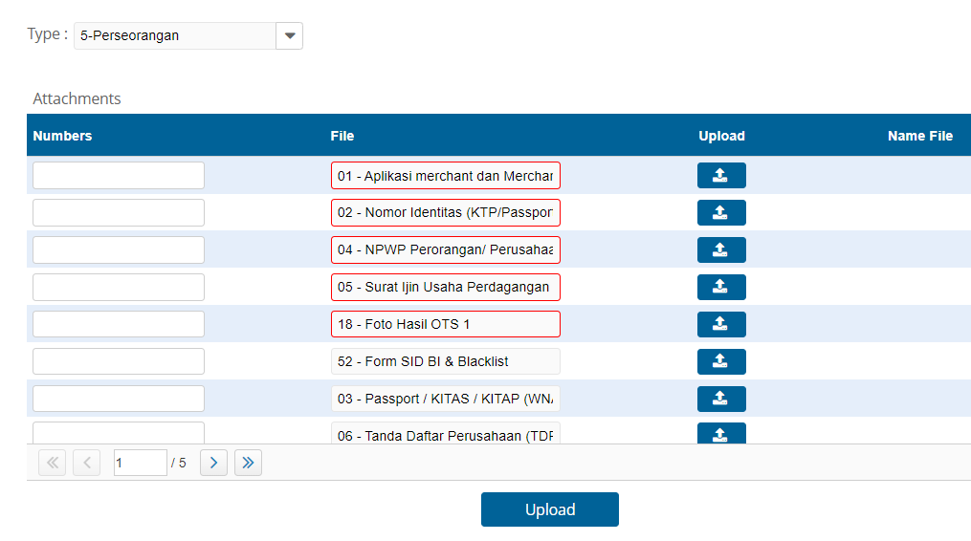
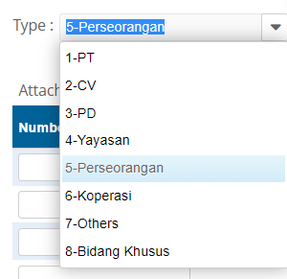
Input Incoming Aplikasi
Upload Dokumen

Slide 16
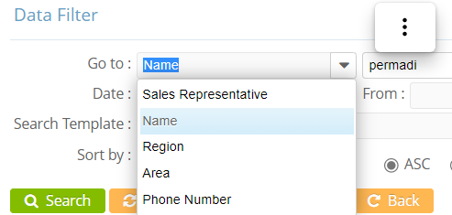
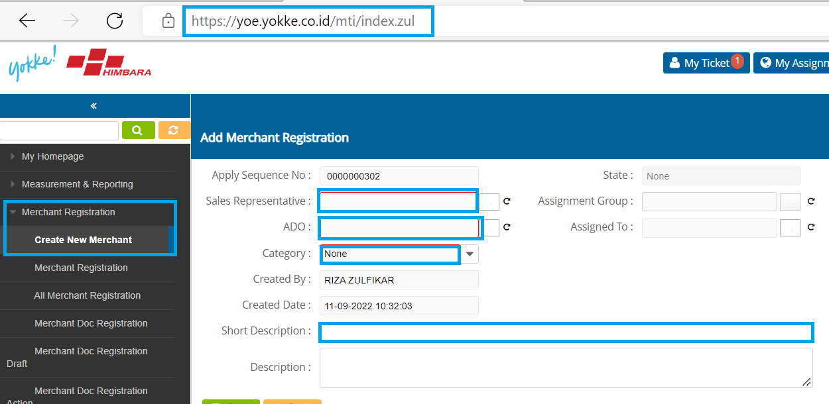
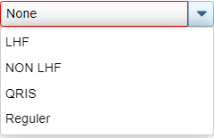
Input Incoming Aplikasi
Create New Merchant
Yoe.yokke.co.id/MTI
Pilih New Merchant
Diisi nama DBA Merchant

Slide 17
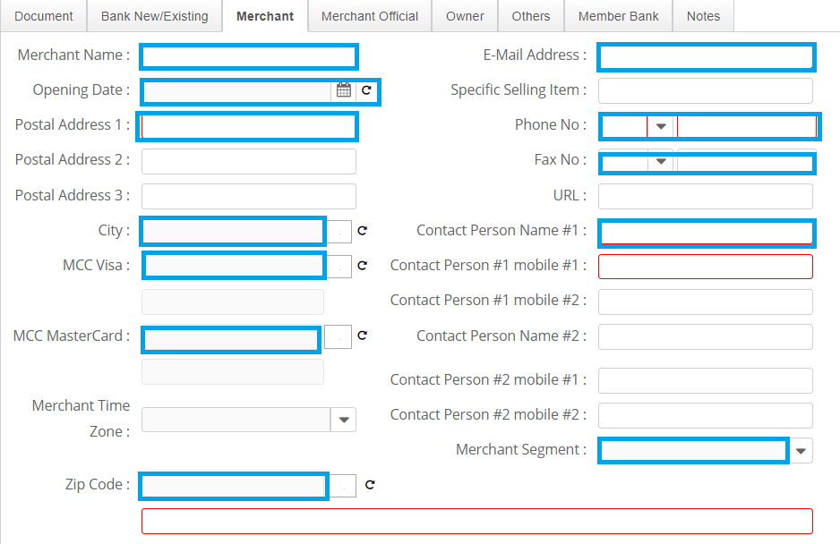
Input Incoming Aplikasi
Merchant

Slide 18
Input Incoming Aplikasi
Merchant Official

Slide 19
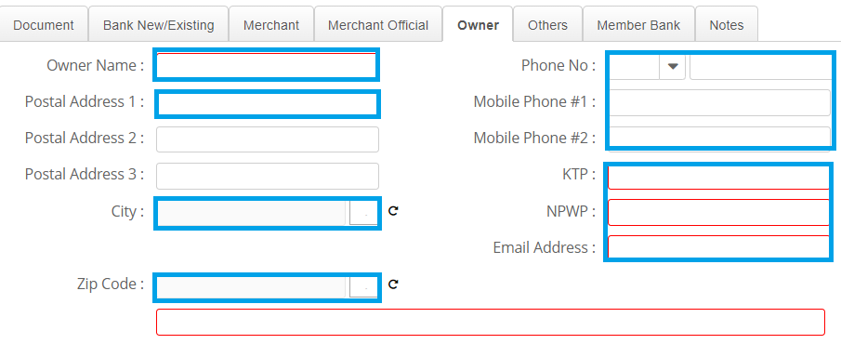
Input Incoming Aplikasi
Owner

Slide 20
Input Incoming Aplikasi
Create New Merchant

Slide 21
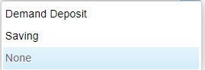
Input Incoming Aplikasi
Member Bank

Slide 22
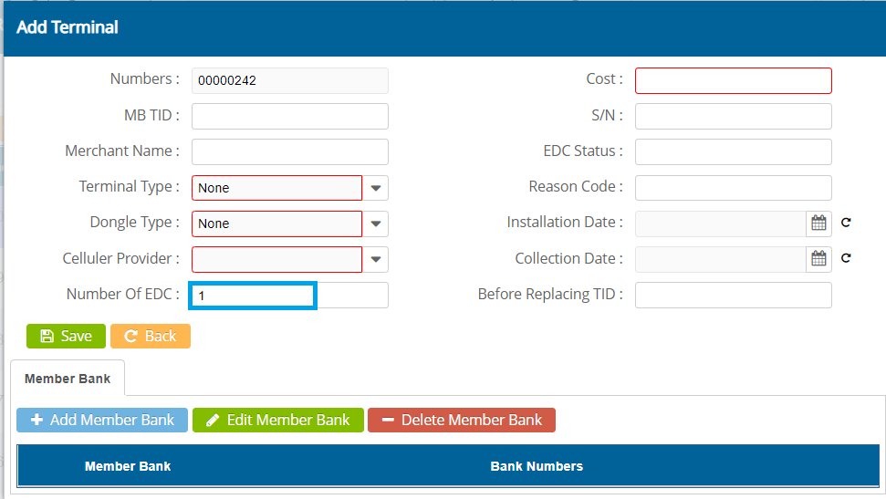
Input Incoming Aplikasi
Jumlah EDC

Slide 23
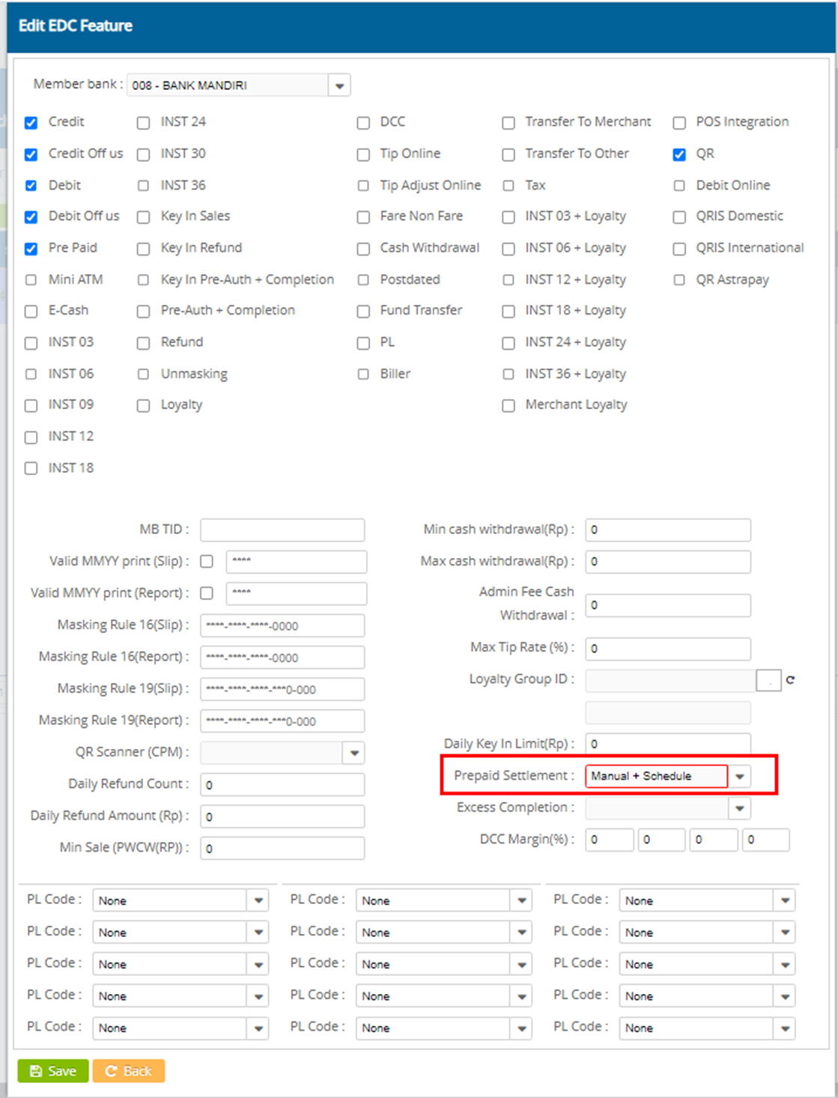
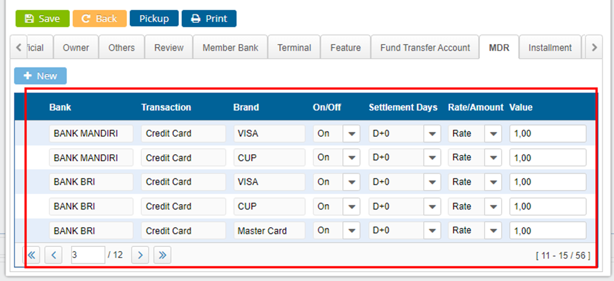
Input Incoming Aplikasi
Feature & MDR

Slide 24
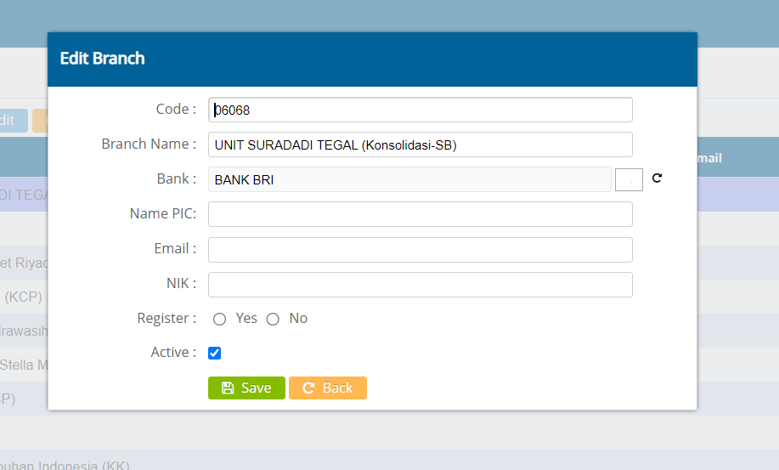
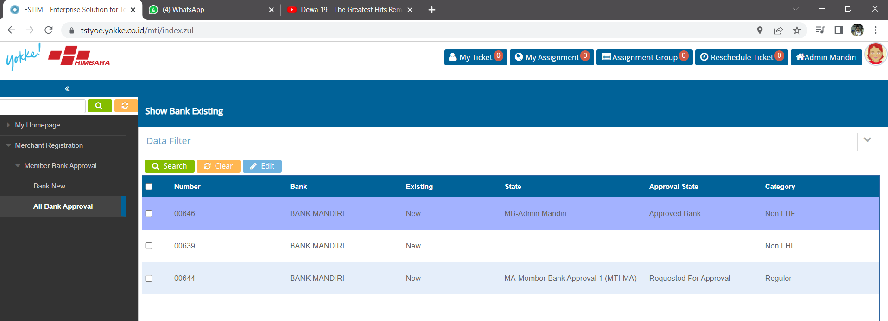
Penambahan Flow approval dan Pickup Aproval
Dilakukan gruping sesuai dengan branch name
Di tambahkan pic Approval sd max 5 Pic
Di tambahkan field Mobile Phone
Di tambahkan 1 flow untuk user approval digital signature
Di lakukan Broadcast via email atau wa Ketika Acquistion Branch

Slide 25
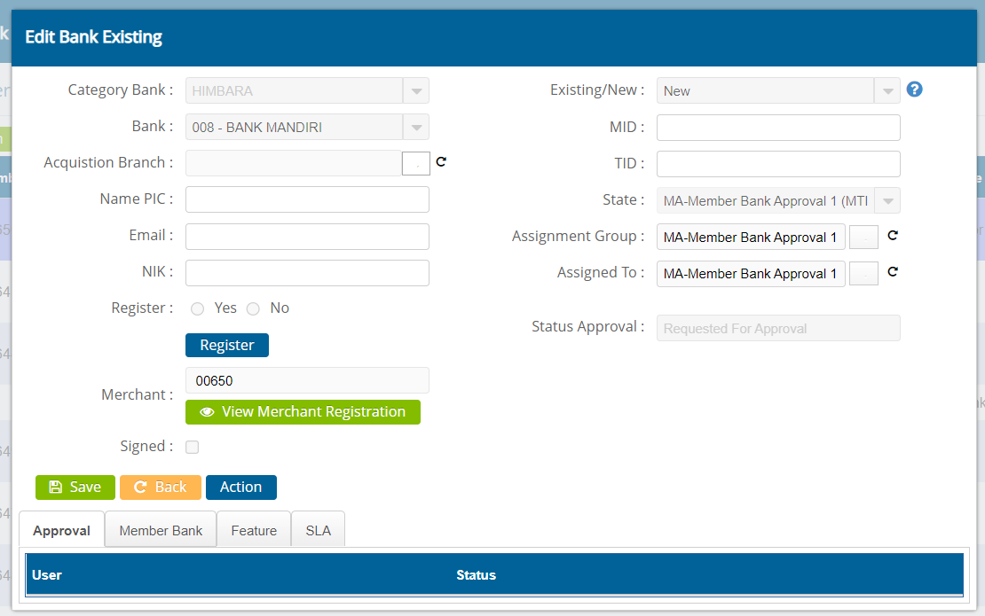
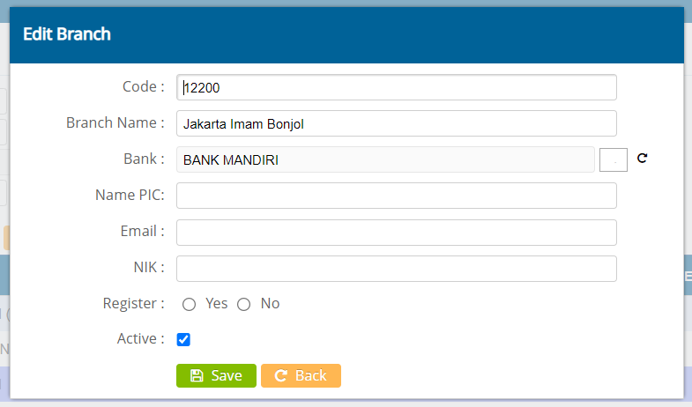
PENAMBAHAN ADMIN BANK DAN DI GRUPING:
1. Ditambahkan maximal 5 pic untuk melakukan tanda tangan Digital Signature 2. Ditambahkan Field Mobile Phone
3. Di buatkan gruping untuk branch name nya dengan max 5 Pic
4. Di lalkukan broadcast untuk reminder digital signature

Slide 26
OCR SYSTEM ONBOARDING
YOE
Capture Document with Phone
Receive API and check Document
OCR Dashboard
YOE DB & FTP Storage
Create File MAAS Via FTP
Send App code dan Image via API to OCR System
Send Response API
Verified and Update Data Image and OCR Result
MAAS
Send Data to YOE Database
send Image File Via FTP
Data entry

Slide 27
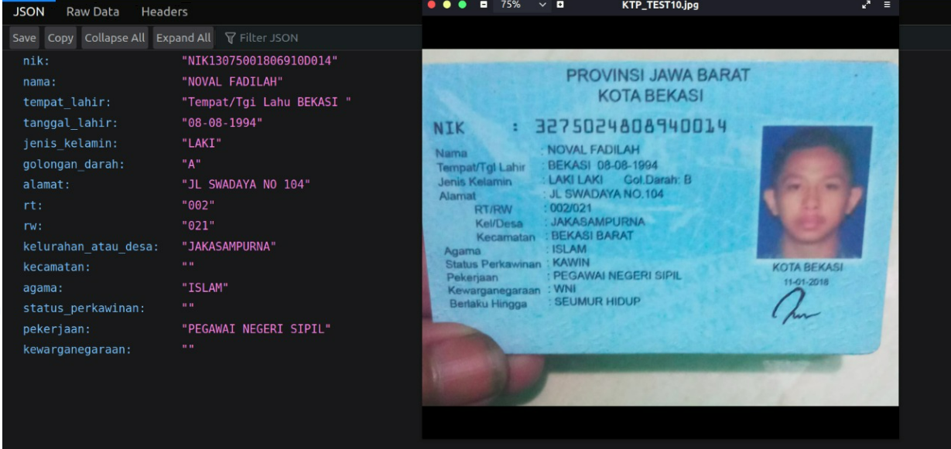
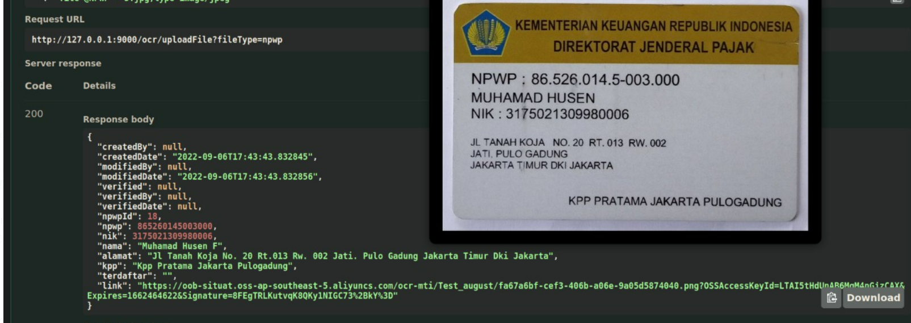
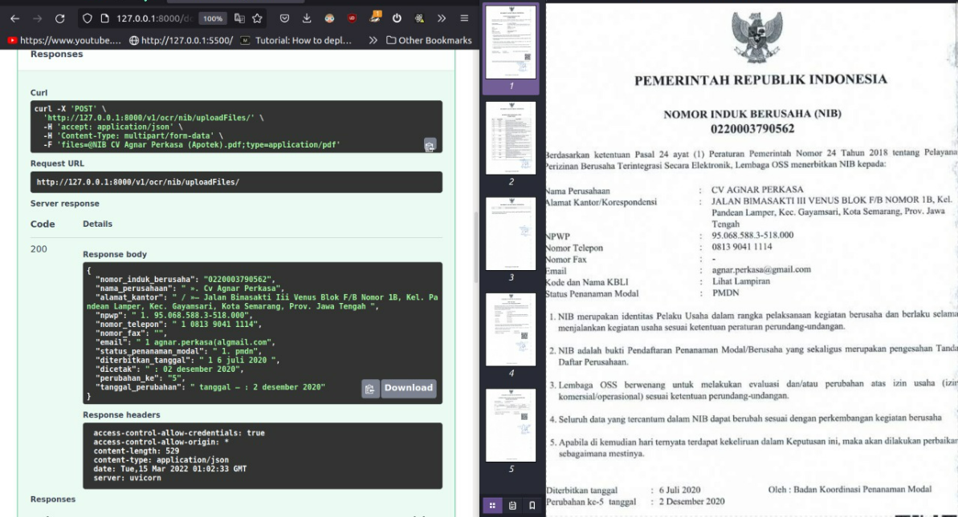

Slide 28
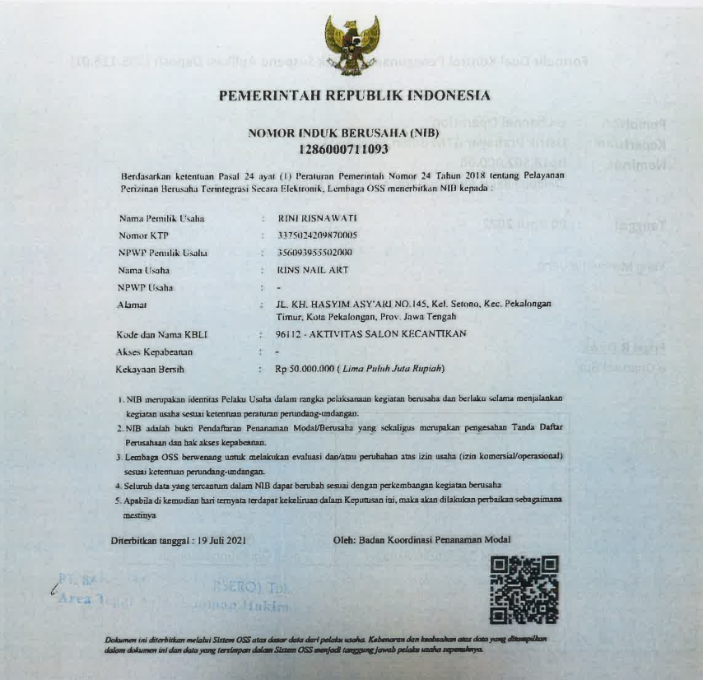
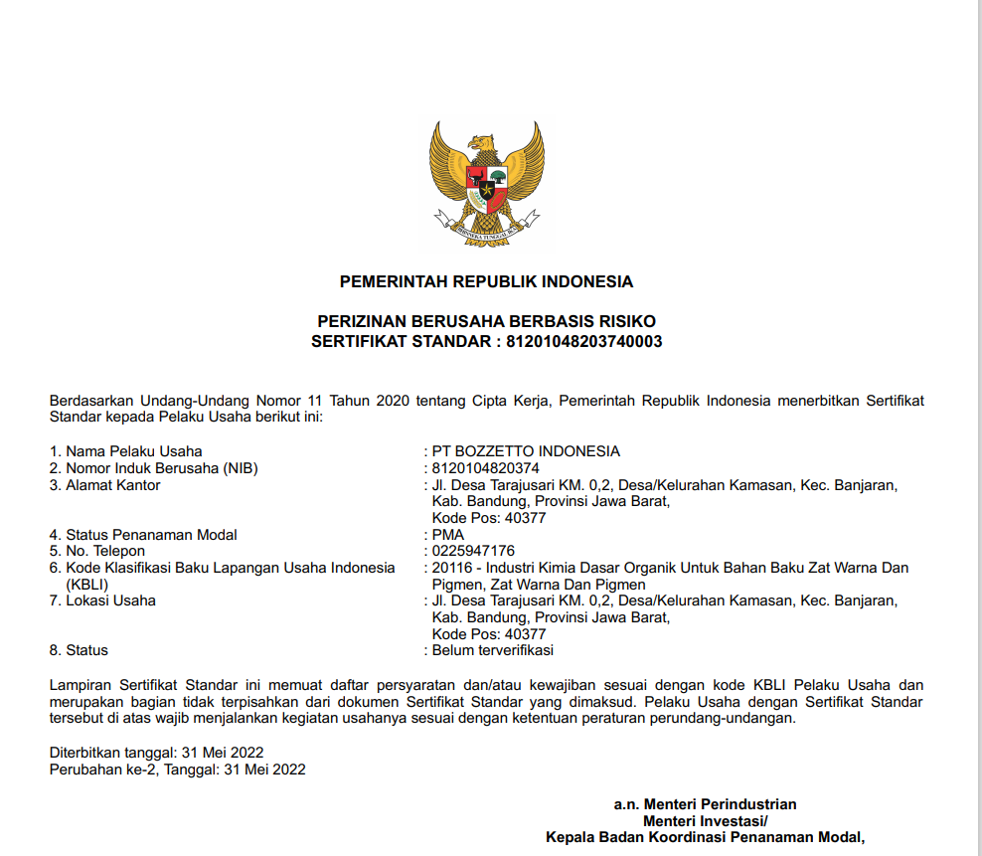

Slide 29
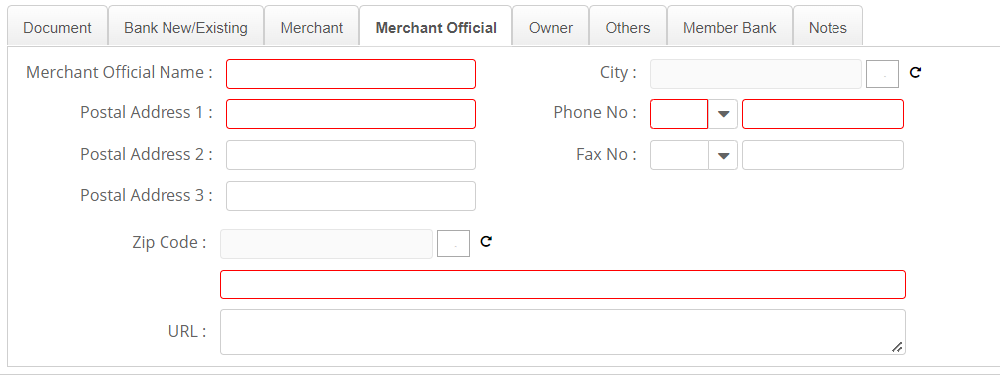
1
3
2
1
2

Slide 30
